Slide 1
Building Evacuations
Select the appropriate evacuation strategy for a building
Determine when elevator evacuations are appropriate
Identify the requirements for fire drills and emergency plans

Slide 2
Historic Fire
1993 World Trade Center

Slide 3


Evacuation Strategies

Slide 4
Hazardous Areas
High-hazard
  75 ft
  Means of egress from other codes
Mechanical rooms
  50 ft (longer with sprinklers and other conditions)
Normally unoccupied spaces
  Less stringent requirements

Slide 5

Elevator Evacuation
Advantages
Problems
Messages
  Content
  Templates

Slide 6
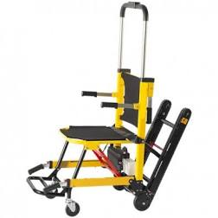
Emergency Stair Travel Devices
Not required
New installations to meet relevant standard

Slide 7
Fire Drills
As required by chapters 11 through 42
Announced or not
Sufficient frequency
  Familiarity
  Identify problems
All persons shall participate
  Training
Availability of exits
Competent persons shall be responsible
Order and discipline -- not speed
Relocate to predetermined location
Cry-wolf
Lost productivity

Slide 8
Emergency Plan
Procedures for reporting of emergencies
Occupant and staff response to emergencies
Evacuation procedures
Appropriateness of the use of elevators
Design and conduct of fire drills
Type and coverage of fire protection systems
Other items required by AHJ
Shall be submitted to AHJ for review
  AHJ sets frequency

